Slide 1
Laboratory: “Customized Embedded Processor Design”
(Application Specific Instruction-Set Processor – ASIP)
Sajjad Hussain

Slide 2
Goal and Tasks of ASIP Lab
Creating new CPUs with new instructions and implementing these instructions in Hardware and Software with evaluation and testing
The main goals are:
creating new ASIPs for special applications
benchmark those ASIPs to find out their benefits and drawbacks
and finally to interpret the benchmark results
Tasks in ASIP Lab
Programming in assembly language
Implementing new instructions (+Simulation, +Hardware)
Evaluating the results from the new CPU
Creating different CPU versions depending on the given optimization
Total Weekly Sessions: 8 ECTS Points: 4
3-4 hours of each session
Students are split into groups of 2 or 3
Final Session: Mini Project & Presentation

Slide 3
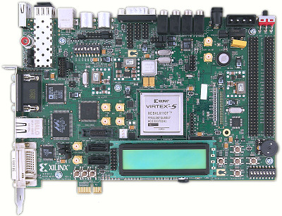
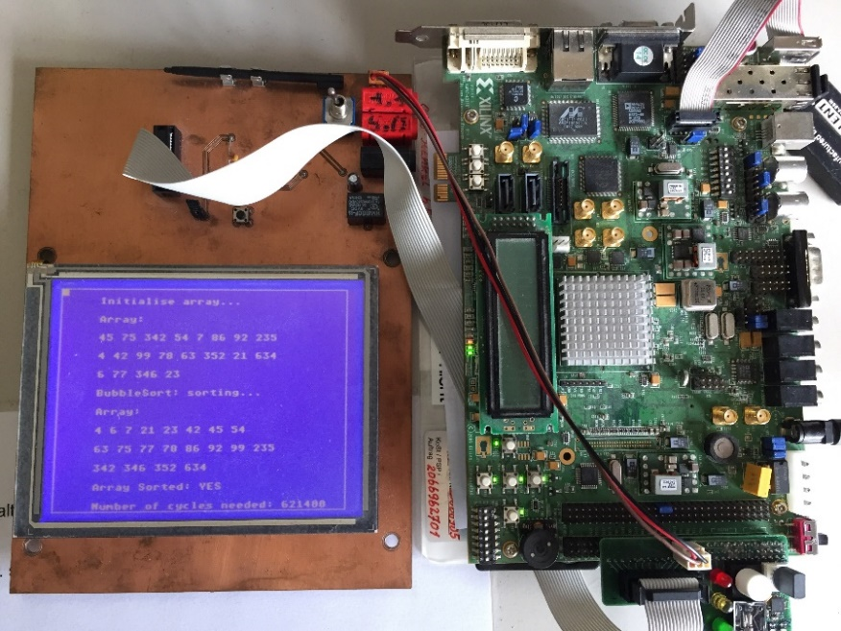
Lab Environments
dlxsim: Instruction Set Simulator adapted for Brownie Processor
ASIPMeister: To create new processor
Extended GCC compiler: compiler out of an processor architecture description in ASIPMeister.
ModelSim: simulator for VHDL-Code
Xilinx ISE: Synthesis and PNR of VHDL-Code
XPower: To estimate power consumption
Scripts: To integrate & automate all these tools

Slide 4
Improvements
Updated the Lab in 2018 ✓
Bought recent version of ASIPmeister
Bugs are removed, Easy to use, Multiple Instances, Compiler Generation
Accordingly improved the: ✓
Lab Scripts
Xilinx ISE Framework
Adapted DLX-Sim Simulator
Sessions/Examples
LCD, UART and other accessories are functional now
Improved lab documentation
Advertising Pamphlet
TODO
Efficient Advertisement (e.g., Pamphlet)
In Computer Organization/Architecture Courses
In Electrical Department
Change of Lab Structure???

Slide 5
Thanks

Slide 6
Comments / Feedback
CRITICAL: Update attractiveness of Homepage / Figures / Layout
There once was a description about the lab and used tools with figures etc. Where is that? That should be placed prominent on our homepage and in best case also in Campusmanagement if possible (or a link in Campusmanagement etc.)
Applies to all labs
Maybe Consider Vivado/7-series FPGAs
Adding ASIP Lab as part of ES Lab would be manual effort for the students (rather than automatic as it is in the ASIP lab), i.e. it would be a really different task (VHDL programming rather than automatically generating new custom instructions) and it would be really time consuming and thus hard to integrate it is part of an other lab.

